Slide 1
Oral Surgery Club GB annual accounts 2
1st Oct ‘25 – 30th Sept ‘26

Slide 2
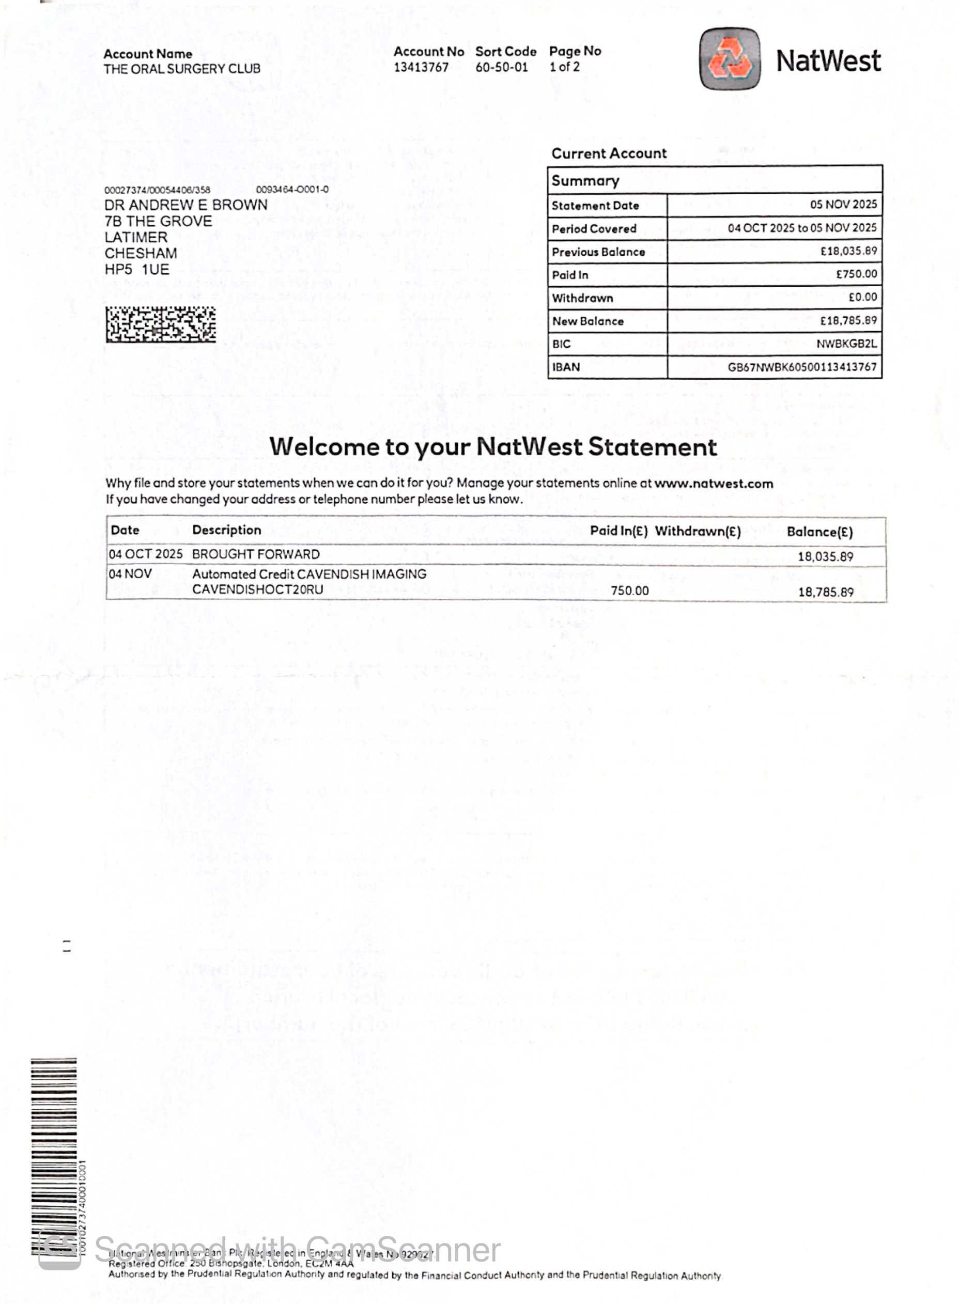
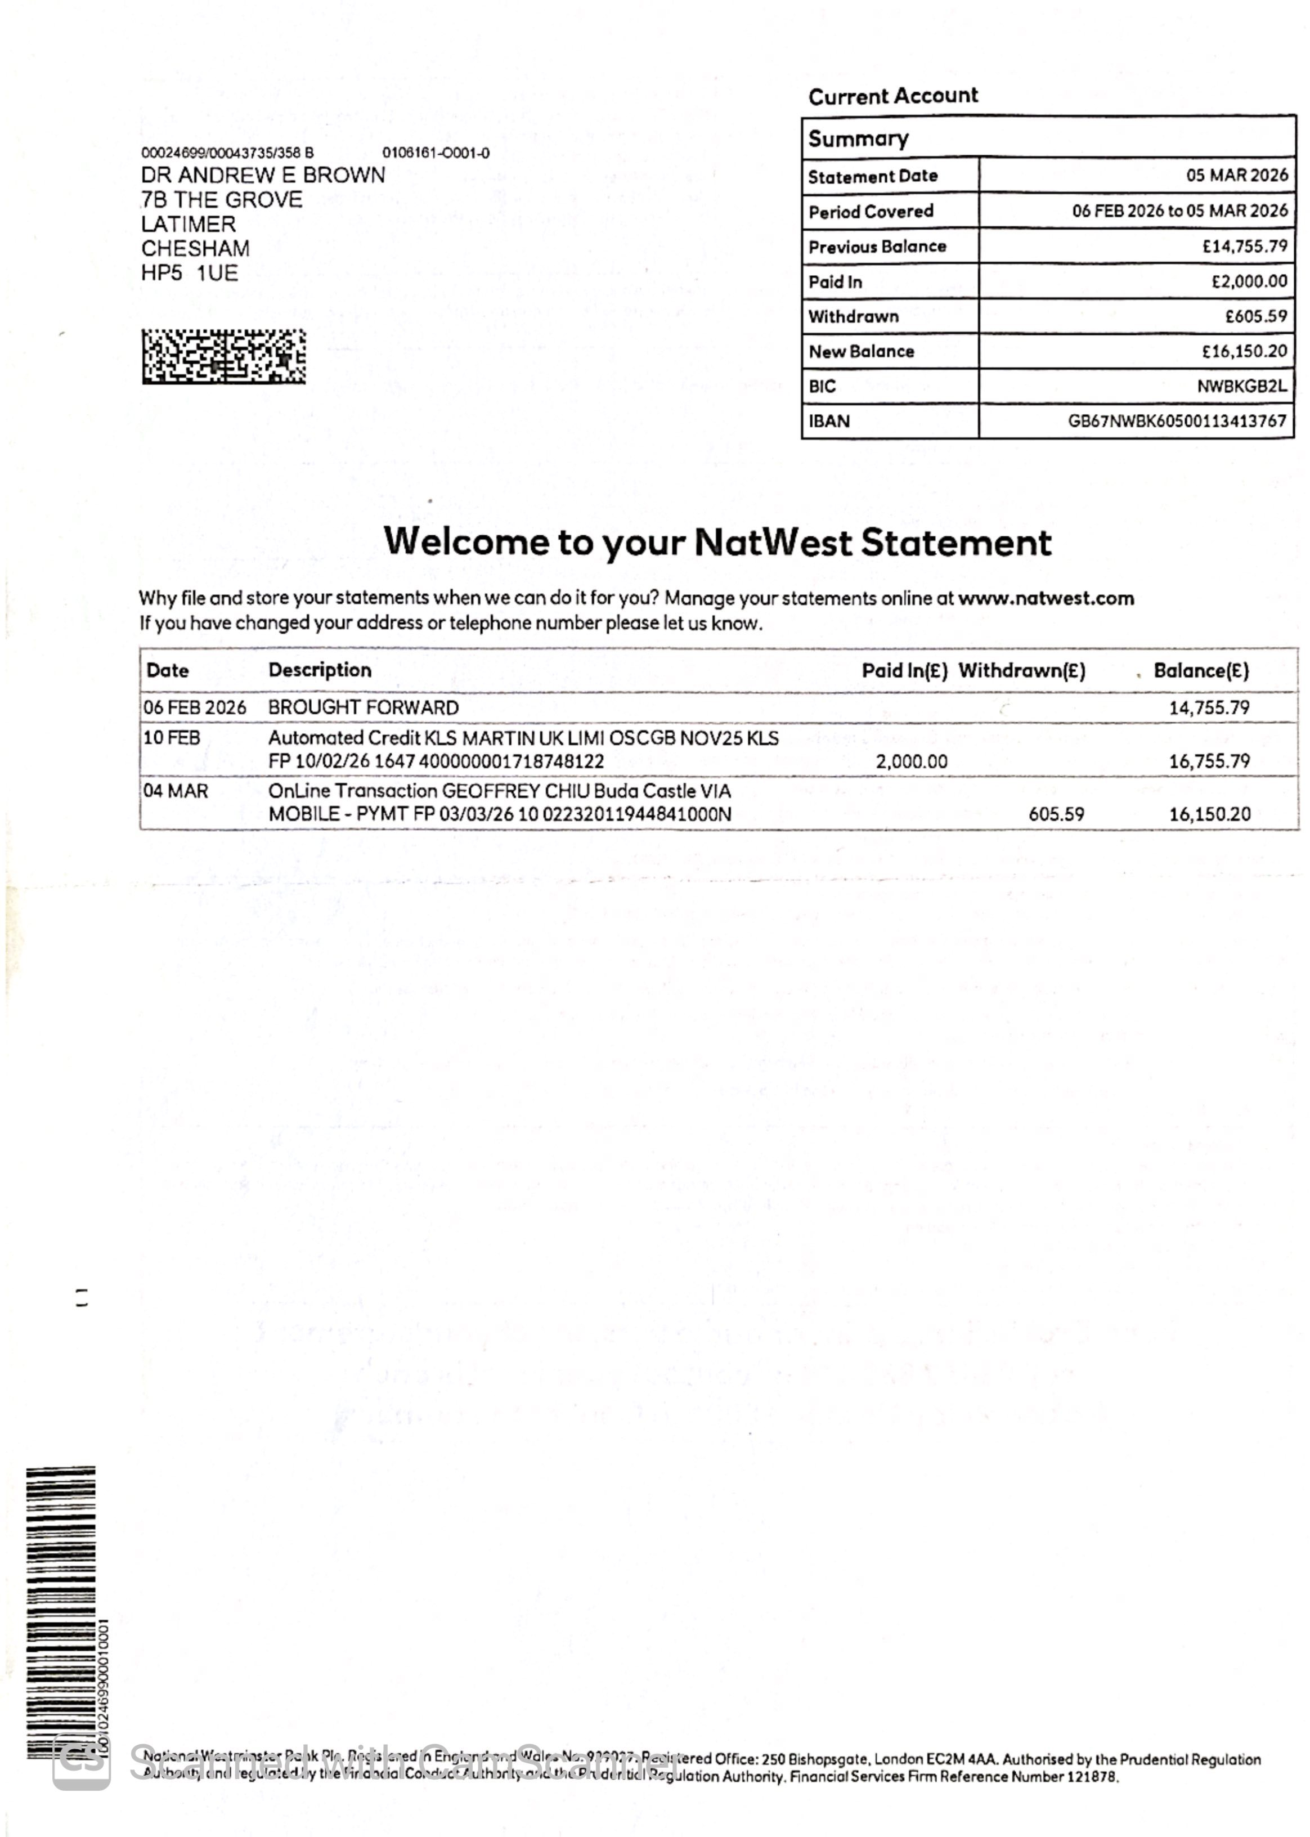
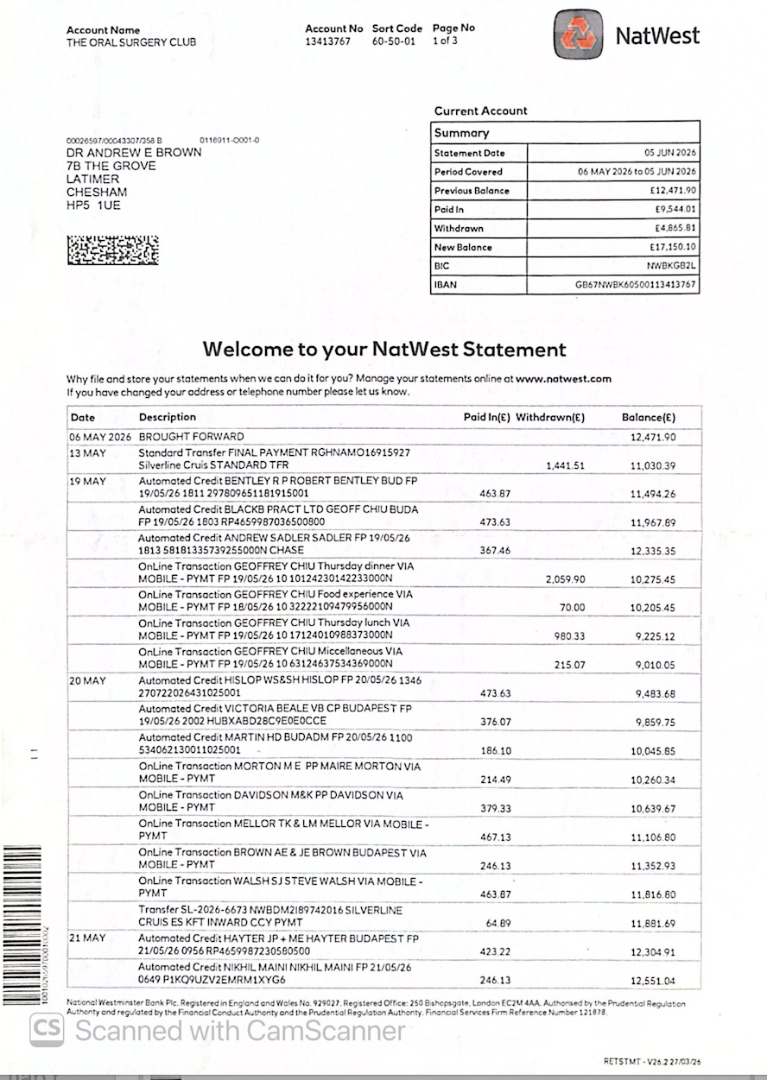
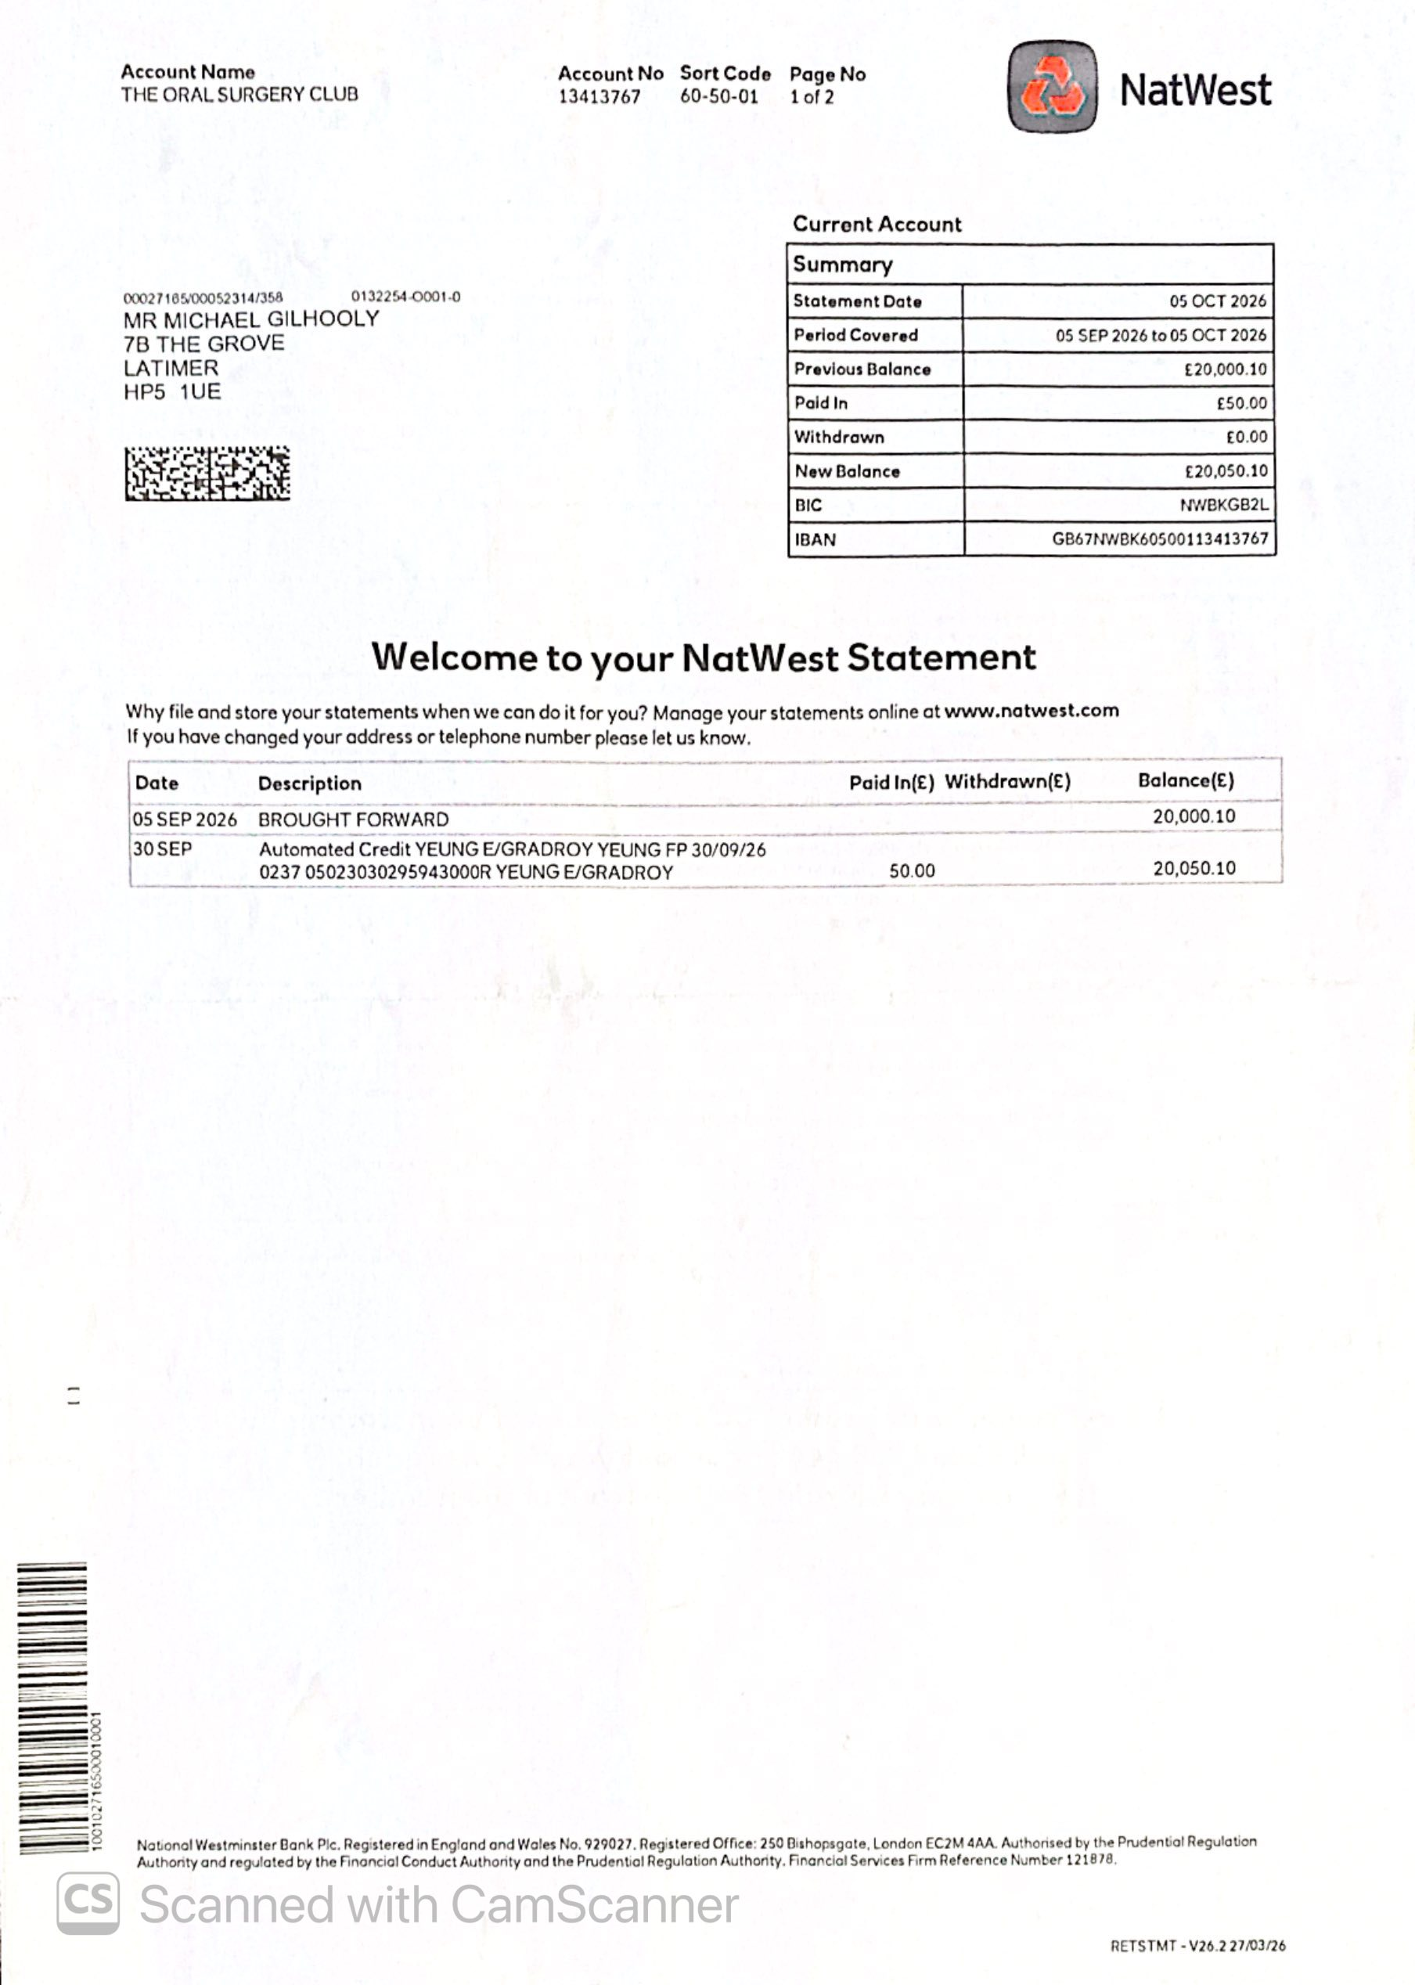
Q1
Q2
Q3
Q4

Slide 3
